Slide 1
Utility Scale Wind Energy Development
Siting Issues, Concerns, & Conflict Resolution
December 18, 2013
Notes:
Presenter Notes: The 2012 Public and Land-Grant Conference on Energy Challenges conference proceedings reads, “Turn a switch …..and turn on what may be the most important problem facing humanity. At a minimum, by mid-century, we need to find some way of generating an incredible amount of energy, ……10 terawatts.... and for worldwide prosperity,…..we must do this in a environmentally sustained fashion and it has to be cheap

Slide 2
Todays Presenters
Eric Romich
Field Specialist, Energy Development at Ohio State University Extension
Wayne Beyea
Extension Specialist, School of Planning, Design & Construction at Michigan State University
Peggy Hall
Director, Agricultural & Resource Law Program at The Ohio State University
Business Development
Conflict Resolution
Siting
Notes:
Presenter Notes: Public opinion polls have found generally high levels of support for wind power. For example, a 2008 MIT survey on energy, found that nearly 75% of people in the U.S. either support or strongly support the siting of a wind energy facility within 25 mi of their home (Ansolabehere and Konisky, 2009). This was far greater than support for coal, natural gas, and nuclear facilities. Yet, despite strong support for wind energy in principle, specific projects are frequently met with strong local opposition (Kintisch, 2010) sometimes with where opposition groups have been successful at slowing, but not necessarily stopping, development projects (Aitken et al., 2008).

Slide 3
Program Agenda
NCRCRD Project Overview
Business Development
Project Siting
Community Outreach & Conflict Resolution
How to Access to Curriculum Materials
Notes:
Presenter Notes:

Slide 4
The Situation
“Renewable energy, however, is widely accepted as having broad environmental benefits by reducing harmful emissions. Yet, opponents often cite local environmental impacts, such as harm to wildlife or impacts to the visual landscape, as reasons for challenging the construction of renewable energy facilities. As such, these conflicts have been characterized as “green on green” conflicts (Warren et al., 2005), pitting global environmental interests against local preservationists.”
Bidwell, D., The role of values in public beliefs and attitudes towards commercial wind energy. Energy Policy (2013), http://dx.doi.org/10.1016/j.enpol.2013.03.010i
Notes:
Presenter Notes: Public opinion polls have found generally high levels of support for wind power. For example, a recent energy survey in an Ohio county and found that respondents in the proposed development zone were significantly less likely to support wind development in their county, than those located in other areas of the county. In fact 73% of respondents located outside the development zone indicated they support of strongly support wind development in their county compared to only 48% of respondents located in the development zone.
Yet, despite strong support for wind energy in principle, specific projects are frequently met with strong local opposition (Kintisch, 2010) sometimes with where opposition groups have been successful at slowing, and sometimes stopping, development projects (Aitken et al., 2008).

Slide 5
NCRCRD Project Overview
Our team will make use of case studies, best practices, and field survey research to identify the issues and opportunities related to renewable energy projects.
Integrate findings into the development of a 3 module curriculum including topics on:
Business/Project Development
Utility Siting Issues and Concerns
Methods for Resolving Conflict Involving Renewable Energy Projects.
Notes:
Presenter Notes: This is the first of three modules focused on utility scale wind energy development, project siting, and community conflict resolution. This module provides an introduction to renewable energy trends, development drivers, and energy policy. Additionally, this module reviews the business development process of utility scale renewable energy projects and the associated social, economic, and environmental impacts. A primary goal of this module is to improve educators’ understanding of the renewable energy development process and awareness of the potential benefits and challenges to both individuals and communities. Ultimately this curriculum aims to prepare Extension Educators to deliver renewable energy programming that will support informed decision making by local leaders.

Slide 6
Case Study Review
LakeWinds Energy Park
Mason County, Michigan
Generates 100.8 Megawatts (MW) using 56 turbines; enough to power about 54,000 homes.
Gratiot Wind Farm
Generates 218 Megawatts (MW) using 133 turbines; enough to power about 54,000 homes.
Gratiot County, Michigan
Timber Road II
Paulding County, Ohio
Generates 99Megawatts (MW) using 55 turbines; enough to power about 27,000 homes.
Blue Creek Wind Farm
Van Wert, Ohio
Generates 304 Megawatts (MW) using 152 turbines; enough to power about 76,000 homes.
Notes:
This is just a summary of the four case study locations we analyzed……….

Slide 7
Module 1 – Business Development

Slide 8
Source: U.S. Energy Information Administration, Independent Statistics & Analysis. www.eia.gov
Notes:
Presenter Notes: Human demand for energy is increasing. Factors such as population growth, industrialization, and socioeconomic development result in increased demand for energy. Worldwide energy consumption has grown steadily over the past 30 years. In fact, the total global energy consumption has grown by more than 80% from 283 quadrillion Btu’s in 1980 to over 510 quadrillion Btu’s in 2010. Furthermore, the 2011 International Energy Outlook Report (IEO2011) estimates the world energy consumption will increase to 770 quadrillion Btu by 2035.
In 2010, the U.S. represented roughly 4% of the global population but consumed over 19% of global energy. As you can see in the chart, in 2010 the United States ranked second behind only China in total energy consumption.

Slide 9
Data Source: Global Wind Energy Council www.gwec.net
Notes:
Presenter Notes: As you can see in the chart, installed wind capacity has increased both globally and in the U.S. over the past 16 years.
In fact, the U.S. is second globally in cumulative wind capacity behind only China. From 2002 - 2012 the installed capacity of wind in the U.S. increased by 1,180 percent to over 60,007 megawatts.

Slide 10
U.S. Wind Resource
Notes:
Presenter Notes: Early development of wind farms in the U.S. aligned with high wind resource states in the great plains such as Minnesota, Wyoming, Colorado, Nebraska, Kansas, New Mexico, and Texas. Proper siting in windy locations, away from large obstructions, enhances a wind turbine's performance. In general, annual average wind speeds of 5 meters per second (11 miles per hour) are required for grid-connected applications.
To demonstrate the influence of policy, compare wind resource, RPS, and installed capacity in West Virginia and Pennsylvania to Arkansas.

Slide 11
U.S. Installed Wind Capacity
Notes:
Presenter Notes: Diverse geographic mix of wind installations. As we pointed out earlier Arkansas had the greatest wind resource, but has no RPS, compared to Pennsylvania and West Virginia which do not have as good of a wind resource but had a RPS in place.

Slide 12
States with Renewable Portfolio Standards
Image Source: U.S. Energy Information Administration
Notes:
Presenter Notes: 29 states have RPS Mandates and 8 states have RPS Goals. Once again please take note of the influence of policy by comparing wind resource, renewable portfolio standards, and installed capacity in West Virginia and Pennsylvania to Arkansas.

Slide 13
Notes:
Iowa, Minnesota, and to some extent Illinois were early adopters leading the development of wind farms in the north central region. Now reflecting on the wind resource map you will recall all three states have a strong wind resource. The rest of the region started to see some significant investment around 2006 and 2007.
To once again restate the influence of policy on development, in 2006 three of the NCRCRD states had some type of RPS compared to 9 states in 2008.

Slide 14
Wind Development Process
Ten Steps for Wind Farm Development
Understand the Wind Resource
Determine Proximity to transmission
Secure Access to Land
Establish Access to Capital
Identify a Power Purchaser
Design Site in Context of Local Landscape
Procure Equipment that is Best Suited to the Regional Economic Realities
Obtain Planning and Zoning Approval
Establish Contracts with Engineering Firms, Developers, and Turbine Manufacturers
Secure Operations and Maintenance
Source: Adapted from American Wind Energy Association Factsheet
Notes:
Presenter Notes: Here are the critical steps in wind the development process:
Understand the Wind Resource
Determine Proximity to transmission
Secure Access to Land
Establish Access to Capital
Identify a Power Purchaser
Design Site in Context of Local Landscape
Procure Equipment that is Best Suited to the Regional Economic Realities
Obtain Planning and Zoning Approval
Establish Contracts with Engineering Firms, Developers, and Turbine Manufacturers
Secure Operations and Maintenance
While every project will a little different, but in general will follow this process. The critical thing to consider as an Extension Educator is the timing. It is important to understand if wind has potential in your community and then to listen for signs of landowners being contacted. Wind development is a long term process often taking 5 to 6 years.
Survey evidence also indicates that people’s viewpoints are critically influenced by the nature of the planning and development process: the earlier, more open and participatory the process, the greater the likelihood of public support (Warren et al., 2005).

Slide 15
Module 2 – Utility Scale Wind Energy Development

Slide 16
What Will This Module Provide?
Understand the utility scale siting process.
Assess public attitudes and critical issues related to Utility Scale Wind Energy Development.
Examine community responses to siting of wind energy towers.
Identify best practices for policy development and regulation to address local concerns.
Review case studies of local siting of utility scale wind farms.

Slide 17
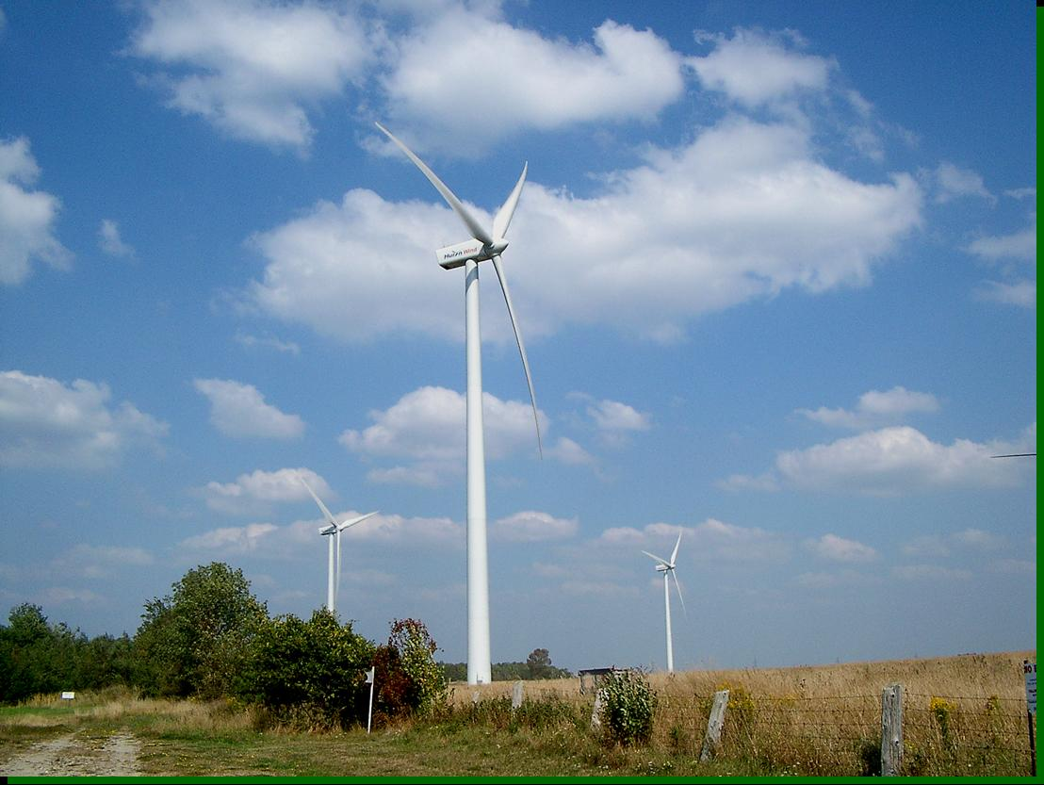
Why Wind?
Wind as an energy resource
Economic, social, environmental impacts
Notes:
WHAT DOES THIS IMAGE EVOKE?
Electricity generation is responsible for 36% of carbon dioxide pollution, 64% of sulfur dioxide pollution, 26% of nitrogen oxide pollution, and 40% of mercury pollution in the U.S.

Slide 18
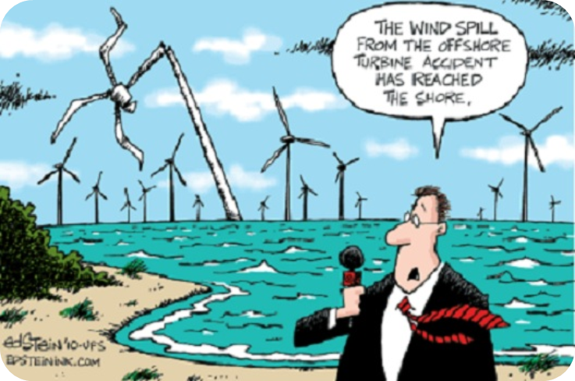
Attitudes and Context
What are the public attitudes towards wind?
Source: www.independentaustralia.net

Slide 19
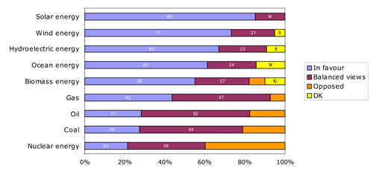
Public Attitude: Europe
Source: European Commission (2007c)

Slide 20
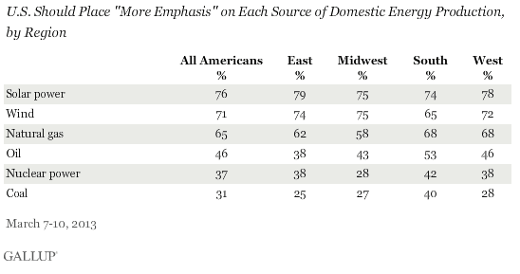
US Public Attitudes

Slide 21
Top Issues & Concerns
Pros & Cons of Wind Energy

Slide 22
Pros and Cons
Proponents:
wind power can supplement other sources
wind power is never going to rise in cost
wind power does not pollute the air or water
wind turbines are visually appealing
wind turbines are not too noisy
wind power increases national security
Opponents:
wind power is intermittent
wind turbines spoil the scenery
wind turbines are noisy
wind turbines are dangerous
wind turbines kill too many birds
wind power is too expensive
Notes:
Eric has this slide already…

Slide 23
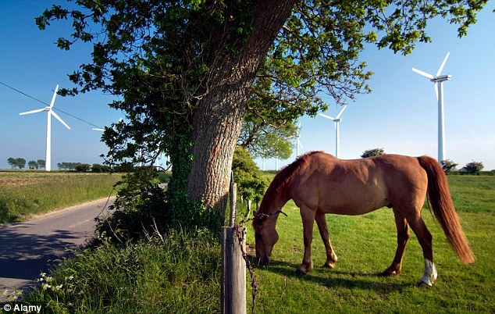
Siting Issues
Safety
Tower Height
Tower Setbacks
Tower Construction Materials
Spacing & Distribution
Noise Pollution
Shadow Flicker
Property Values
Aesthetics
Overhead / Underground Wires
Decommissioning
Wildlife Impact
State Law
Source: toryaardvark.com

Slide 24
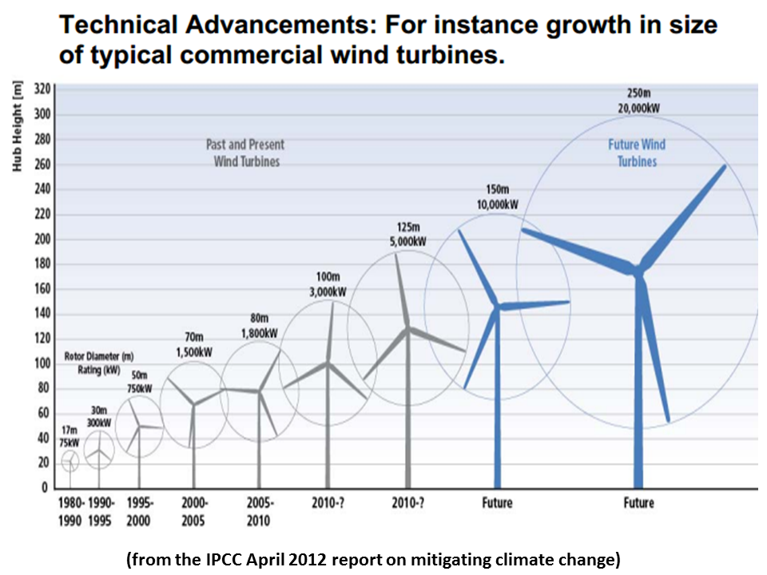
Turbine Size
Larger turbines capture more wind so communities with less than superb wind resources may end up with the largest turbines

Slide 25
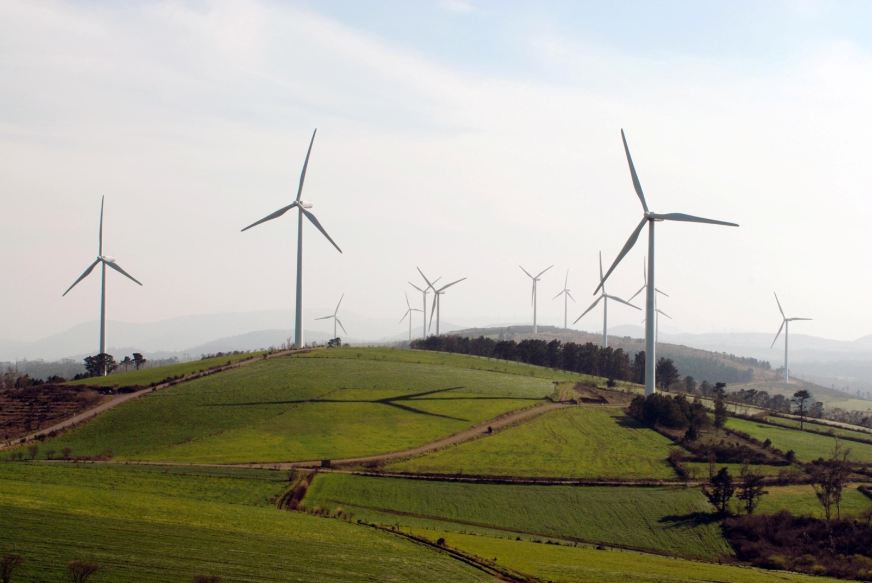
Spacing and Distribution
Turbines are placed in linear fashion in open spaces or at higher elevation than surrounding land.
Less often, turbines are clustered. Both approaches impact the skyline.
Source: www. sites.psu.edu

Slide 26
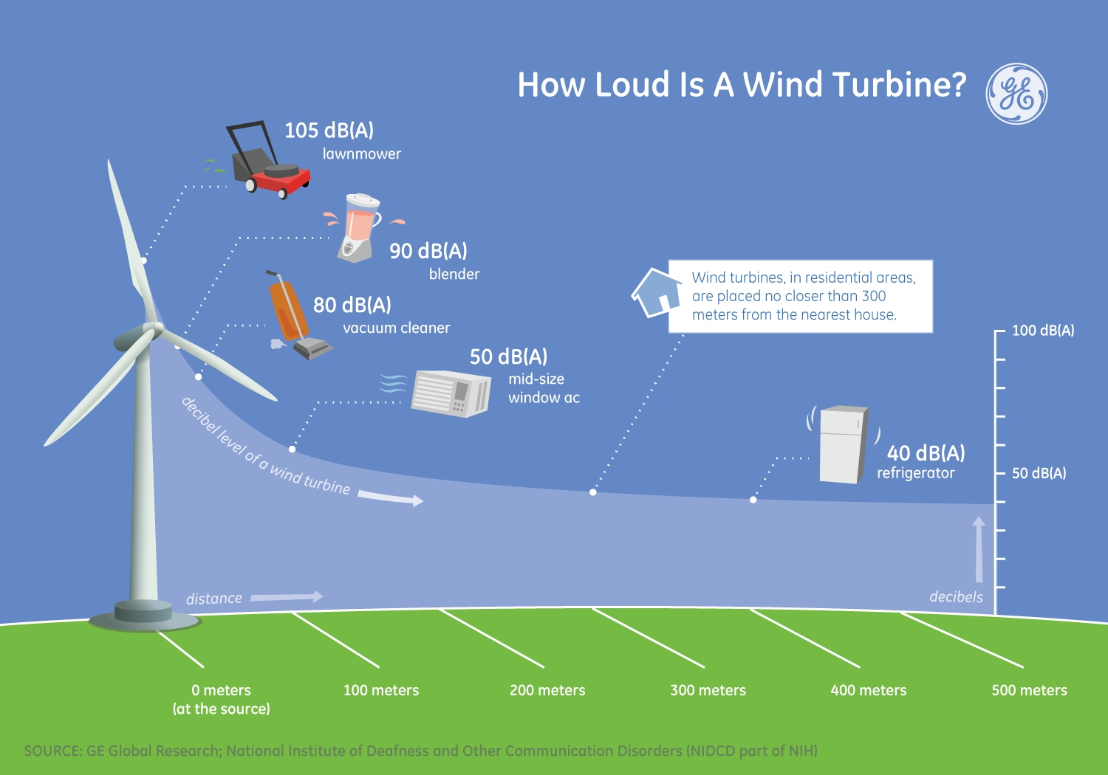
Noise Pollution

Slide 27
Case Study Conclusions
A total of 4 wind farms (2 Ohio & 2 Michigan) were analyzed
A summary of relevant findings include:
Developer
The level of engagement by the developer and/or applicant throughout the process impacts the level of acceptance.
Regulatory Review
The perceived level of control to permit wind farms may impact the level of engagement by citizens
Public Participation
Early awareness, knowledge, and conflict resolution about wind farms before applications are submitted and during the process is key

Slide 28
Module 3 Conflict Resolution

Slide 29
Conflict and Wind Energy: The “Social Gap”
The “social gap:” (Bell et al, 2005)
High general support for renewable energy is incongruent with a slow rate of deployment for renewable energy technologies.
Wind energy and the social gap:
Public opinion polls indicate high levels of individual support for renewable energy, including wind energy.
But opposition to specific wind projects is common.
And organized opposition at the federal/state policy levels is becoming more common.

Slide 30
What’s Causing the Social Gap?
Several research-based theories:
NIMBY effect?
Socioeconomic and geographic factors?
Hartman et al (2011) - Common opposition motivations:
Misinformation
Self-interest
Prudence
Distrust

Slide 31
What’s Causing the Social Gap?
Several research-based theories:
Bidwell (2013) – Wind energy acceptance factors:
Anticipated effects
Fairness of development
Values and beliefs

Slide 32
Opposition Factors: Key Points for Conflict Resolution
Anticipated effects/siting concerns.
Distrust.
Broad concerns for community.
Landscape impacts.
Threats to personal identities that are tied to personally valued landscapes.
General environmental beliefs that are tied to conservatism and traditionalism.
Beliefs about likely economic outcomes.

Slide 33
How to Address Wind Energy Opposition?
Consideration of opposition factors.
Education
Levels of acceptance increase with increased knowledge.
Engagement
With intent to find solutions rather than to “convert” the opposition.
Collaborative problem solving.
Individually and collaboratively.

Slide 34
Education Strategies
Early education about wind energy generally.
Meetings on specific project, before the public approval process.
Education led by coalition of project “champions” from community.
Open houses with experts in attendance.
Distribution of academic research and studies.
Wind farm tours for community members.

Slide 35
Engagement Strategies
Use of a community advisory panel.
Involve in project design and siting?
Engagement with project developer.
“Kitchen table” meetings with residents.
Store front “open door” offices for project.
Conduct additional studies to address concerns.
Indicate willingness to make project revisions.
Generally and individually
Make monetary payments?

Slide 36
Is the Conflict “too Intense”?
May need Environmental Conflict Resolution
Third-party assisted collaborative problem solving and resolution of environmental and natural resource conflicts.
Principles of ECR – a highly formal process:
Informed commitment
Balanced, voluntary representation
Group autonomy
Informed process
Accountability
Openness
Timeliness

Slide 37
Upcoming Extended Webinar
Detailed explanations of engagement and problem solving strategies.
Analysis of techniques and solutions to address specific types of opposition.
Analysis of our case studies.
Recommendations for Extension’s role in community engagement and conflict resolution.

Slide 38
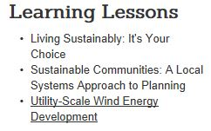
eXtension Curriculum
The Utility Scale Wind Energy Development course can be found at: http://www.extension.org/community_planning_and_zoning
The course consists of the following:
Introduction to Utility Scale Wind Energy Development (75 minute webinar)
Three (3) core modules:
Module 1: Business Development (80 minute webinar)
Module 2: Wind Project Siting (75 minute webinar)
Module 3: Conflict Resolution (60 minute webinar)
Tools for Teachers
Case Study Analysis, logic model, white paper, teaching outlines, energy specialist contact list, and program evaluation
Certificate of Completion
To learn more about eXtension: http://www.extension.org

Slide 39
Questions?
Eric Romich
Field Specialist, Energy Development
Ohio State University Extension
romich.2@osu.edu
Wayne Beyea
School of Planning, Design & Construction
Michigan State University
beyea@msu.edu
Peggy Hall
Agricultural & Resource Law Program
Ohio State University Extension
aglaw@osu.edu

